Slide 1
Tracheostomy care
Ata Mahmoodpoor. MD.FCCM
Professor of Anesthesiology
TBZMed. 2023

Slide 2
Keeping the tube in place
Suctioning
Cleaning
Bathing
Clothing
Stoma care
Exchanging
Cuff management
Communication
Decanulation

Slide 9
Tracheostomy tubes are angled or curved. Angled tracheostomy tubes have a curved portion and a straight portion. They enter the trachea at a less acute angle and may exert less pressure at the stoma.
Because the portion of the tube that extends into the trachea is straight and conforms more closely to the natural anatomy of the airway, the angled tube may be better centered in the trachea and exert less pressure along the tracheal wall.
Low-profile tracheostomy tubes have a small discrete flange and are used in patients with a laryngectomy or sleep apnea. Percutaneous tracheostomy tubes have a tapered distal tip, a low-profile cuff designed to reduce insertion insertion force, and an inverted cuff shoulder for easier insertion.

Slide 12
If the tracheostomy tube is too short, the distal end can obstruct against the posterior tracheal wall. This can be remedied by using a larger tube, an angled tube, a tube with a flexible shaft, or a tube with extra length. Extra length tubes are constructed with extra proximal length (horizontal extra length) or with extra distal length (vertical extra length).
Extra proximal length facilitates tracheostomy tube placement in patients with a large neck (eg, obese patients).
Extra distal length facilitates placement in patients with tracheomalacia or tracheal anomalies. Care must be taken to avoid inappropriate use of these tubes because they may induce distal obstruction of the tube

Slide 25
Accidental decanulation
4/1000 tracheostomy days

Slide 30
Heat Moisture Exchanger (HME)
Contains a hygroscopic paper surface that absorbs the moisture in expired air. Upon inspiration the air passes over the hygroscopic paper surface and moistens and warms the air that passes into the airway.
HME is recommended for all patients with a tracheostomy tube.
HME fit directly onto the tracheostomy tube.
Do not wet the HME filter prior to use
HME are changed daily or as needed if the filter appears to be excessively moist or blocked.
For small infants <10kg some HME filters may not be suitable. Consult Respiratory team to assess patient 's suitability
HME with oxygen and suction port are suitable for low flow oxygen administration (as per oxygen delivery guideline)

Slide 31
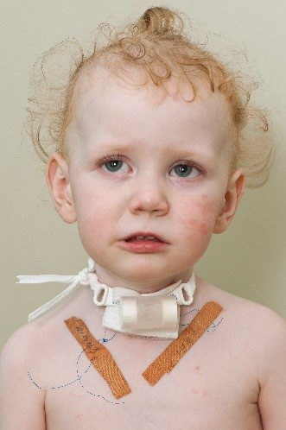

Slide 32
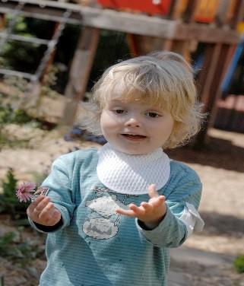
Tracheostomy bibs
Consist of a specialized foam that traps the
moisture in the expired air, upon inspiration the
foam moistens and warms the air.
These are changed daily or more frequently.
Tracheostomy bibs are reusable - hand wash
in warm water using a mild detergent/soap,
then rinse thoroughly and allow to air dry.
Tracheostomy bibs should be discarded monthly or more frequently if discoloured or the material is damaged.

Slide 33
Benefits of using a one-way speaking valve include:
Enhancing normal flow of air through the airway/nose and mouth
Restoration of physiological PEEP
Louder and clearer voice
Improved ability to taste and smell food
Improved secretion management
Improved protection of the airways during swallowing and feeding
Improves development of speech and babbling in infants/toddlers
Contraindications for one-way speaking valve assessment:
Severe airway obstruction
Vocal cord paralysis - adducted (closed) position
Severe neurological deficit
Tracheostomy tube with inflated cuff (any kind)
Foam-filled cuff (even if deflated)
Severe risk for aspiration
Less than 7 days post-operative tracheostomy tube insertion

Slide 34
Tracheostomy multidisciplinary team

Slide 35
Thank You

